Slide 1
Untitled
[unsubtitled]

Slide 2
Problem Statement(s)!
Media is controlled by a small number of people
Consumers give away too much money and attention in exchange for quality content
Existing mechanisms for funding media are warping our reality
Consumers are not getting access to the best original content
Funding structures for content are stifling innovation and milking old ideas
There are too many people between creators and consumers of media
Middlemen are taking too much of the pie
Subscriptions for paid media are inefficient and restrictive
State-funded media outlets present nationalist viewpoints
State-monopolies restrict access for new entrants
Legacy infrastructure platforms are becoming expensive to maintain and evolve
Fake news.

Slide 3


Slide 4
“Solutions”

Slide 5








Slide 6
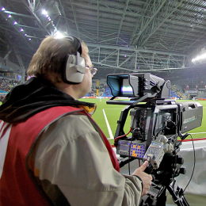

Slide 7
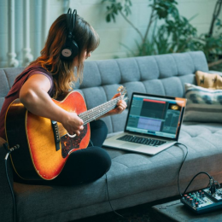

Slide 8
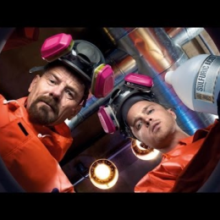

Slide 9


Slide 10
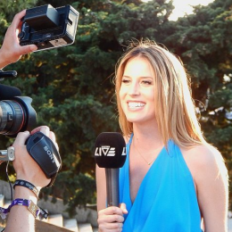

Slide 11

send money
send content

Slide 12
Broadcaster Product Phased Approach
Phase 1 - Broadcaster Registry
Phase 2 - Viewer Mode
Phase 3 - Broadcaster Microsubscriptions
Phase 4 – Viewer-Demanded Transcoding
Phase 5 - Transcoding Cost Sharing
Phase 6 - Viewer Restream / Bootstrap P2P CDN

Slide 13
(Very) High Level Current Architecture
Orchestrator /
Transcoder
Orchestrator /
Transcoder
Broadcaster
Orchestrator /
Transcoder
Service
Registry
Orchestrator /
Transcoder

Slide 14
Phase 1 Broadcaster Registry
Allow a Broadcaster to publish broadcastURI
  Optional
  Register on Ethereum
Question: use existing Service Registry?

Slide 15
Phase 2 Viewer Mode
Start livepeer in “-viewer” mode
Add options via livepeer_cli for viewer to:
  Query serviceRegistry for broadcastURIs
  Query manifests available from broadcastURIs
  Query streams available from manifests
  Play stream (ffplay)

Slide 16
(Very) High Level Future Architecture
Broadcaster
Broadcaster
Viewer
Broadcaster
Service
Registry
Broadcaster

Slide 17
Phase 3 Broadcaster Microsubscriptions
Give Broadcaster option to sell one-segment microsubs.
  e.g. 5s of video
  Paid up-front, otherwise no content is sent
Broadcaster costs: Transcoding, Upstream Bandwidth, Power, Hardware Amortisation, Human Living Costs
Viewer can deposit funds to buy microsubs.
  Question: is Probabilistic Micropayments right for this? Irrespective of gas cost overheads, there is value in the fact that the recipient’s barrier to entry is very low… they only have to spend money on gas when there’s money to withdraw
  Question: optimise for many-to-one or many-to-many?
  Question: Could this be paid in a stablecoin?
  Question: is there a synergy with Basic Attention Token?

Slide 18
Phase 4 Viewer-Demanded Transcoding
Allow a Viewer to request and pay for a Transcoding option not provided by Broadcaster
Increases potential customer-base of Orchestrators / Transcoders
Creates possibility for Broadcaster to have zero external costs, and only revenue

Slide 19
Phase 5 Transcoding Cost Sharing
Viewer 1 requests and pays for additional extra Transcoding option
Viewer 2 of extra Transcoded stream shares costs with Viewer 1
Question: How do we incentivise Viewer 1?

Slide 20
Phase 6 Viewer Restream / P2P CDN
Allow Viewer to configure broadcastURI
Viewer can sell microsubs for restreamed content
  Viewer becomes Curator / Promoter / Distributor
Challenge: design mechanism to get Viewer and Broadcaster collaborating.

Slide 21
(Very) High Level Future Architecture
Viewer
Viewer
Viewer /
Restreamer
Viewer
Viewer
Viewer /
Restreamer
Broadcaster
Viewer
Viewer
Viewer
Viewer /
Restreamer
Viewer
Viewer

